Slide 1


Market
Basket
Analysis
By,
Abhishek K Hiremath

Slide 2

Agenda
1
Executive Summary
Problem Statement
2
About data
Data Characteristics
Exploratory data analysis
Summary & Insights
3
About Market Basket
What is Market Basket?
Approach
KNIME Workflow
4
Associations
Association Rule
Market Basket Recommendations
5
Overall Recommendations

Slide 3

Executive Summary:
Data: from 01-01-2018 to 26-02-2020
Objective: project involves conducting a thorough analysis of Point of Sale (POS) Data for providing recommendations through which a grocery store can increase its revenue by popular combo offers & discounts for customers.
Dataset: We have received the 2 years and 2 months data of a Grocery store. Consisting 20641 entries with 3 variable details regarding the demography of the transaction and item information.
Missing values : None
Duplicate values: 4730
The exploratory analysis and insights provide a clear understanding of the data and highlight the key trends and patterns in sales.
Market Basket Analysis using association rules was performed to identify the relationships between the products purchased by the customers.
This analysis helped to identify the products that are frequently purchased together, which can be used to create lucrative offers for the customers.
Yearly Comparisons (2018 & 2019):
In 2019, a decrease of 26 in the total number of orders compared to 2018.
A decrease of 155 units in the total number of products sold.

Slide 4
Problem Statement
The Company's Data Challenge
A grocery store has entrusted us with their transactional data, seeking a solution to enhance their revenue-generation strategies. They are grappling with optimizing their customer offerings and need data-driven insights to overcome this hurdle.
Objective:
Our objective is to :
Analyse data: Analyze POS data to identify common item combinations in customer orders.
Recommend: Develop data-driven strategies for popular combo offers and discounts.
Increase Revenue: Use insights to boost the grocery store's revenue through tailored customer incentives.

Slide 5

ABOUT DATA

Slide 6
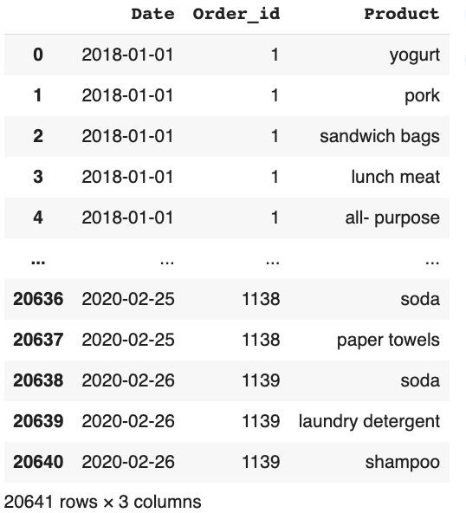
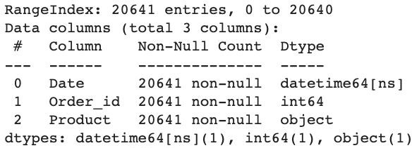
About Data : Data Characteristics
Sample of dataset
Column | Dictionary
Date | Date of Order/Transaction
Order_id | Order ID
Product | Product purchased
Shape of the data: The dataset contains 20641
rows and 3 columns.
Data types : We have the columns with data type as datetime64(1), int64(1), object(1)
Key column includes the Product & Order id
Note: The above data is before Exploratory data analysis & data cleaning

Slide 7
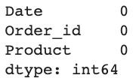
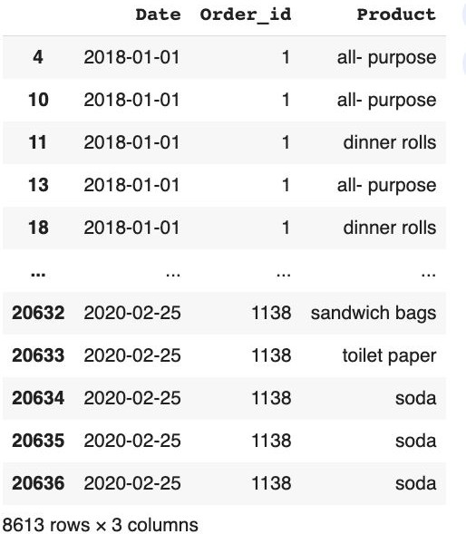
About Data : Data Cleaning
Duplicate Values
Missing values
Duplicate Value check
Insights
No Missing values in the data
4730 duplicates found, that were removed.
Total Unique rows: 15911
No other Irregularity found

Slide 8

Duplicate Values:
It is generally a good practice to drop duplicate rows in a dataset as they do not provide any additional information and can skew the results of any analysis performed on the dataset.
However, in this particular case, dropping duplicate rows may not be appropriate as there is no unique identifier for each row.
Each row consists of a date, a customer ID, and a product purchased, but the same product can be purchased by multiple customers on the same date.
Therefore, we drop duplicate rows, it may inadvertently remove valid information from the dataset.
So duplicate values are not removed from the dataset.

Slide 9

Assumptions:
The data represents a list of items purchased at a grocery store on various dates.
Each entry in the data represents a single item purchased.
The first column in the data represents the date the item was purchased.
The second column represents the customer who made the purchase.
The third column represents the item purchased.
The same item can be purchased by multiple customers on different dates.
There is no information provided about the quantity or price of each item.
We have not dropped the duplicated values.

Slide 10

EXPLORATORY DATA ANALYSIS

Slide 11
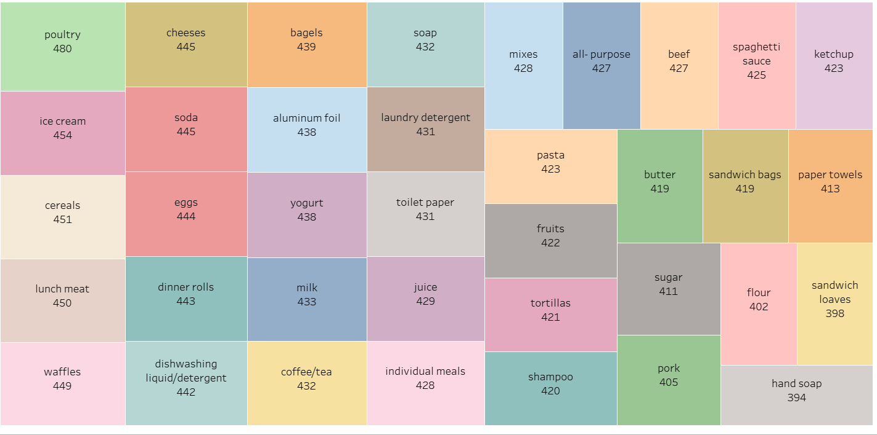
Frequency of Products Sold

Slide 12
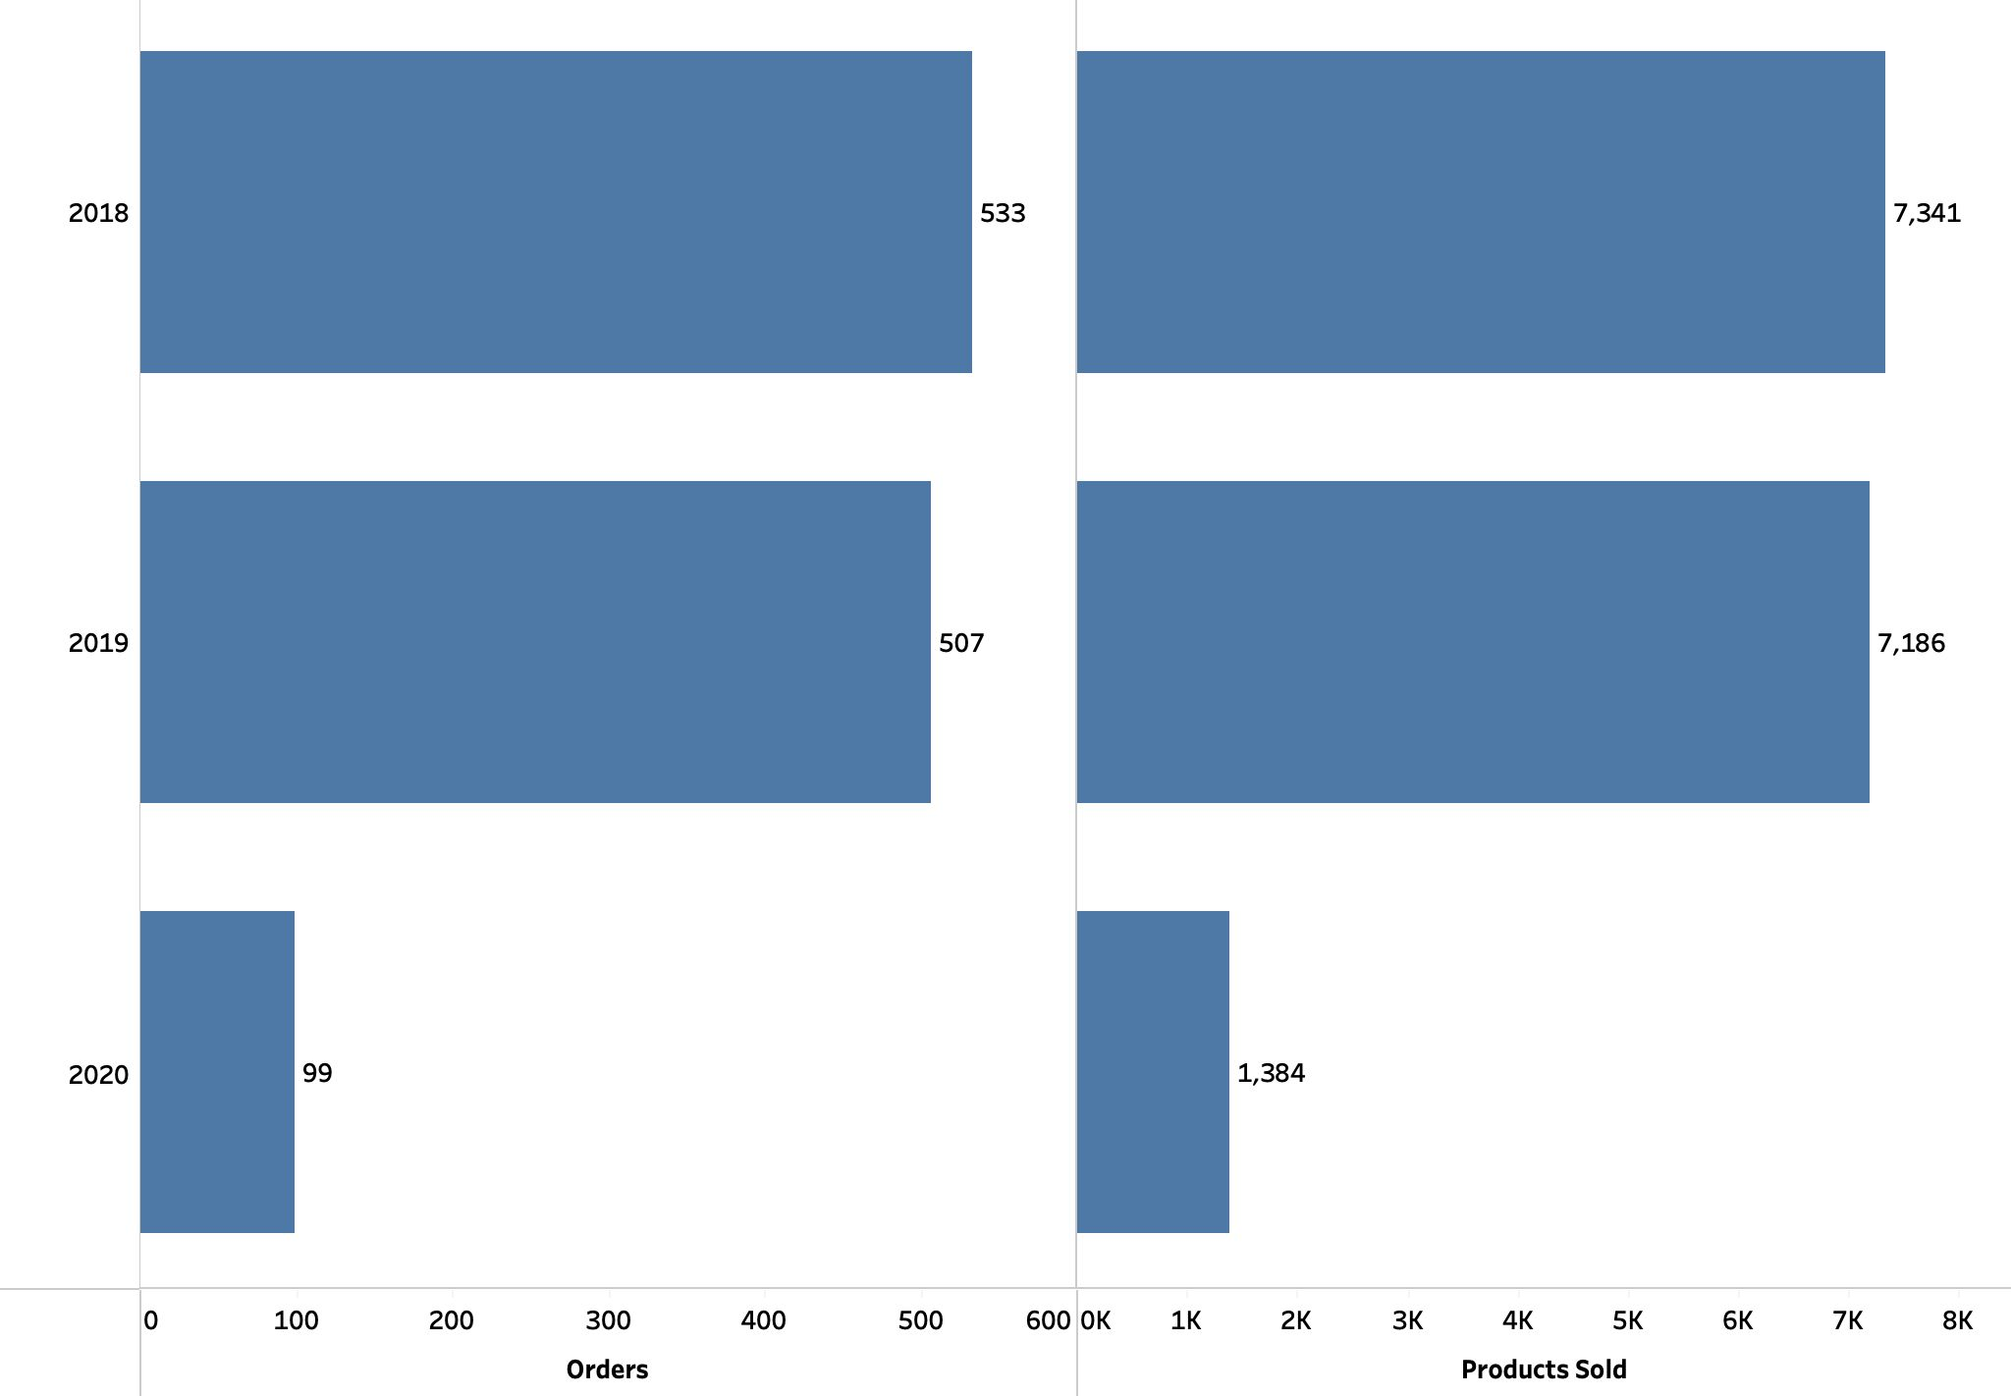
Yearly Orders & Products Sold
Inference:
Decrease in the Total orders and count of products sold in 2019 compared to 2018
The Orders decreased to 507 in
2019 as compared to 533 in 2018
Similarly the Product sold count also reduced to 7186 in 2019 from 7341 in 2018.
*2020 has not been considered as it has only 2 months of data

Slide 13
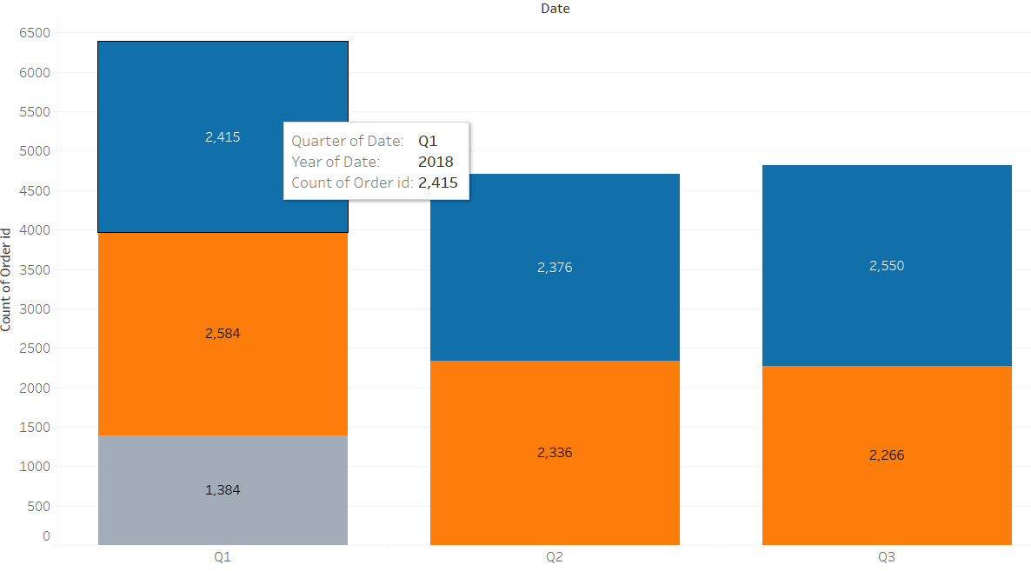
Quarterly Count of Products Sold
Inference:
As we have data till 26 Feb. 2020 that’s why the count of products sold in Q1 is Hight.
In 2019 Q1 sales was highest
In 2018 Q3 sales was highest
Count of product sold in Q2 is approx. same in 2019 and 2018.

Slide 14
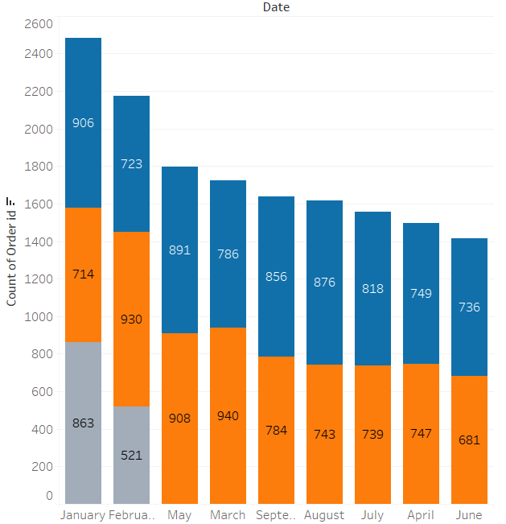
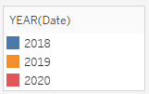
Monthly Count of Products Sold
In 2018 most of the products were sold in January and least were sold in February.
In 2019 most of the products were sold in March and least were sold in January.

Slide 15
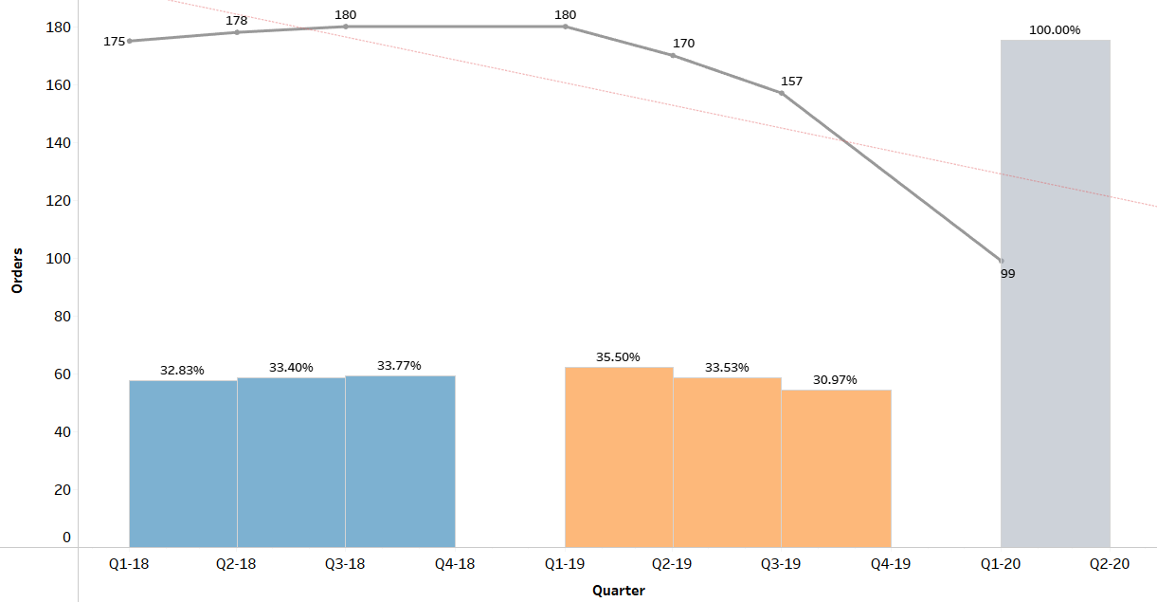
Orders Over Time: Quarterly Orders Placed
Inference:
The Order Trend shows decrease in Sales over time
In 2018, the quarterly trend was slightly increasing, however, in 2019, the sales decreased from Q1 to Q3
No data found for quarter 4 in both 2018 & 2019.This is critical & business need to check immediately for reason
For 2020, only Jan & Feb month data available

Slide 16
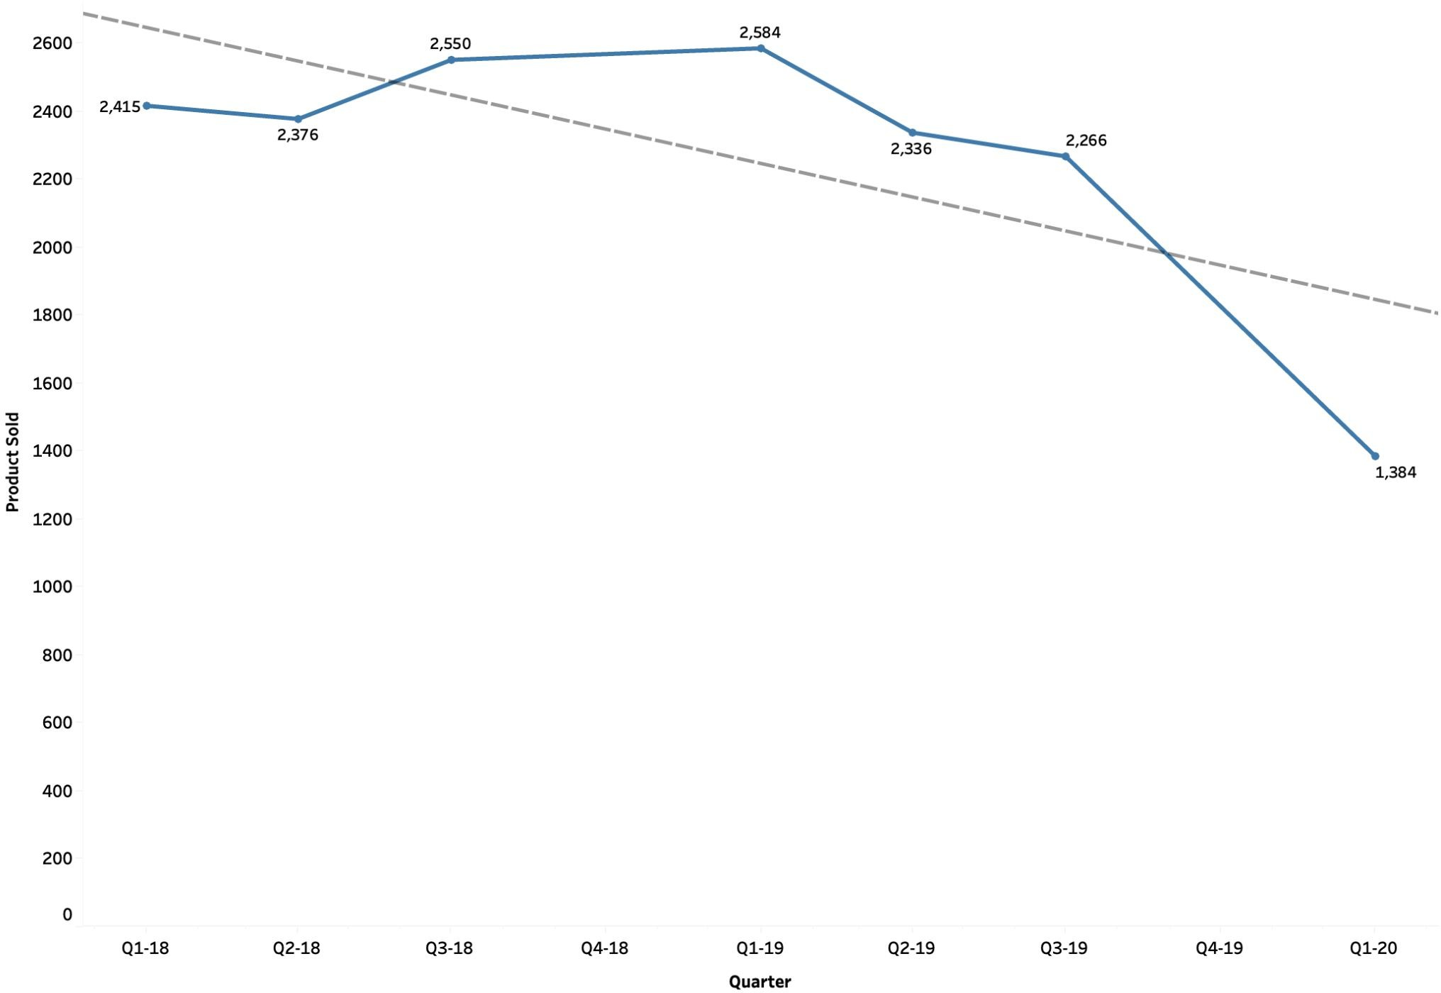
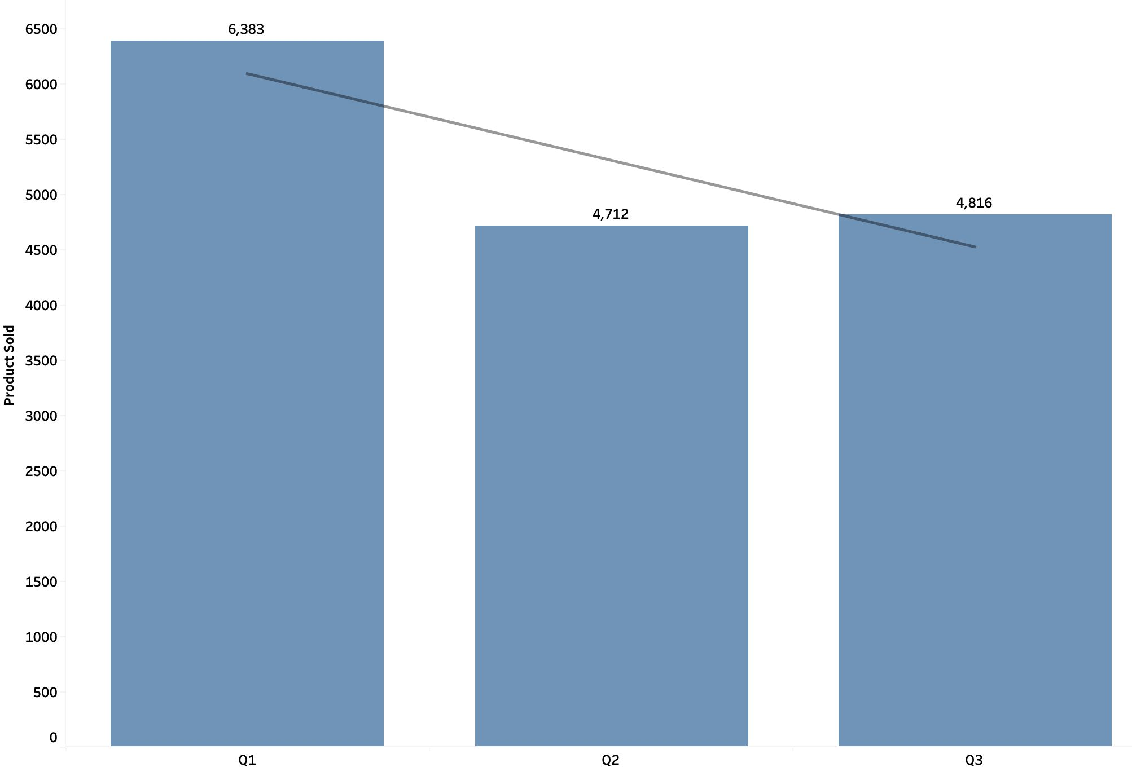
Orders Over Time: Quarterly Products Sold
Inference:
The overall Order Trend is in decreasing Quarter on Quarter
On the entire data, Quarter 1 has the highest sale & Quarter 2 has the lowest
No data found for Q4 in both 2018 & 2019

Slide 17
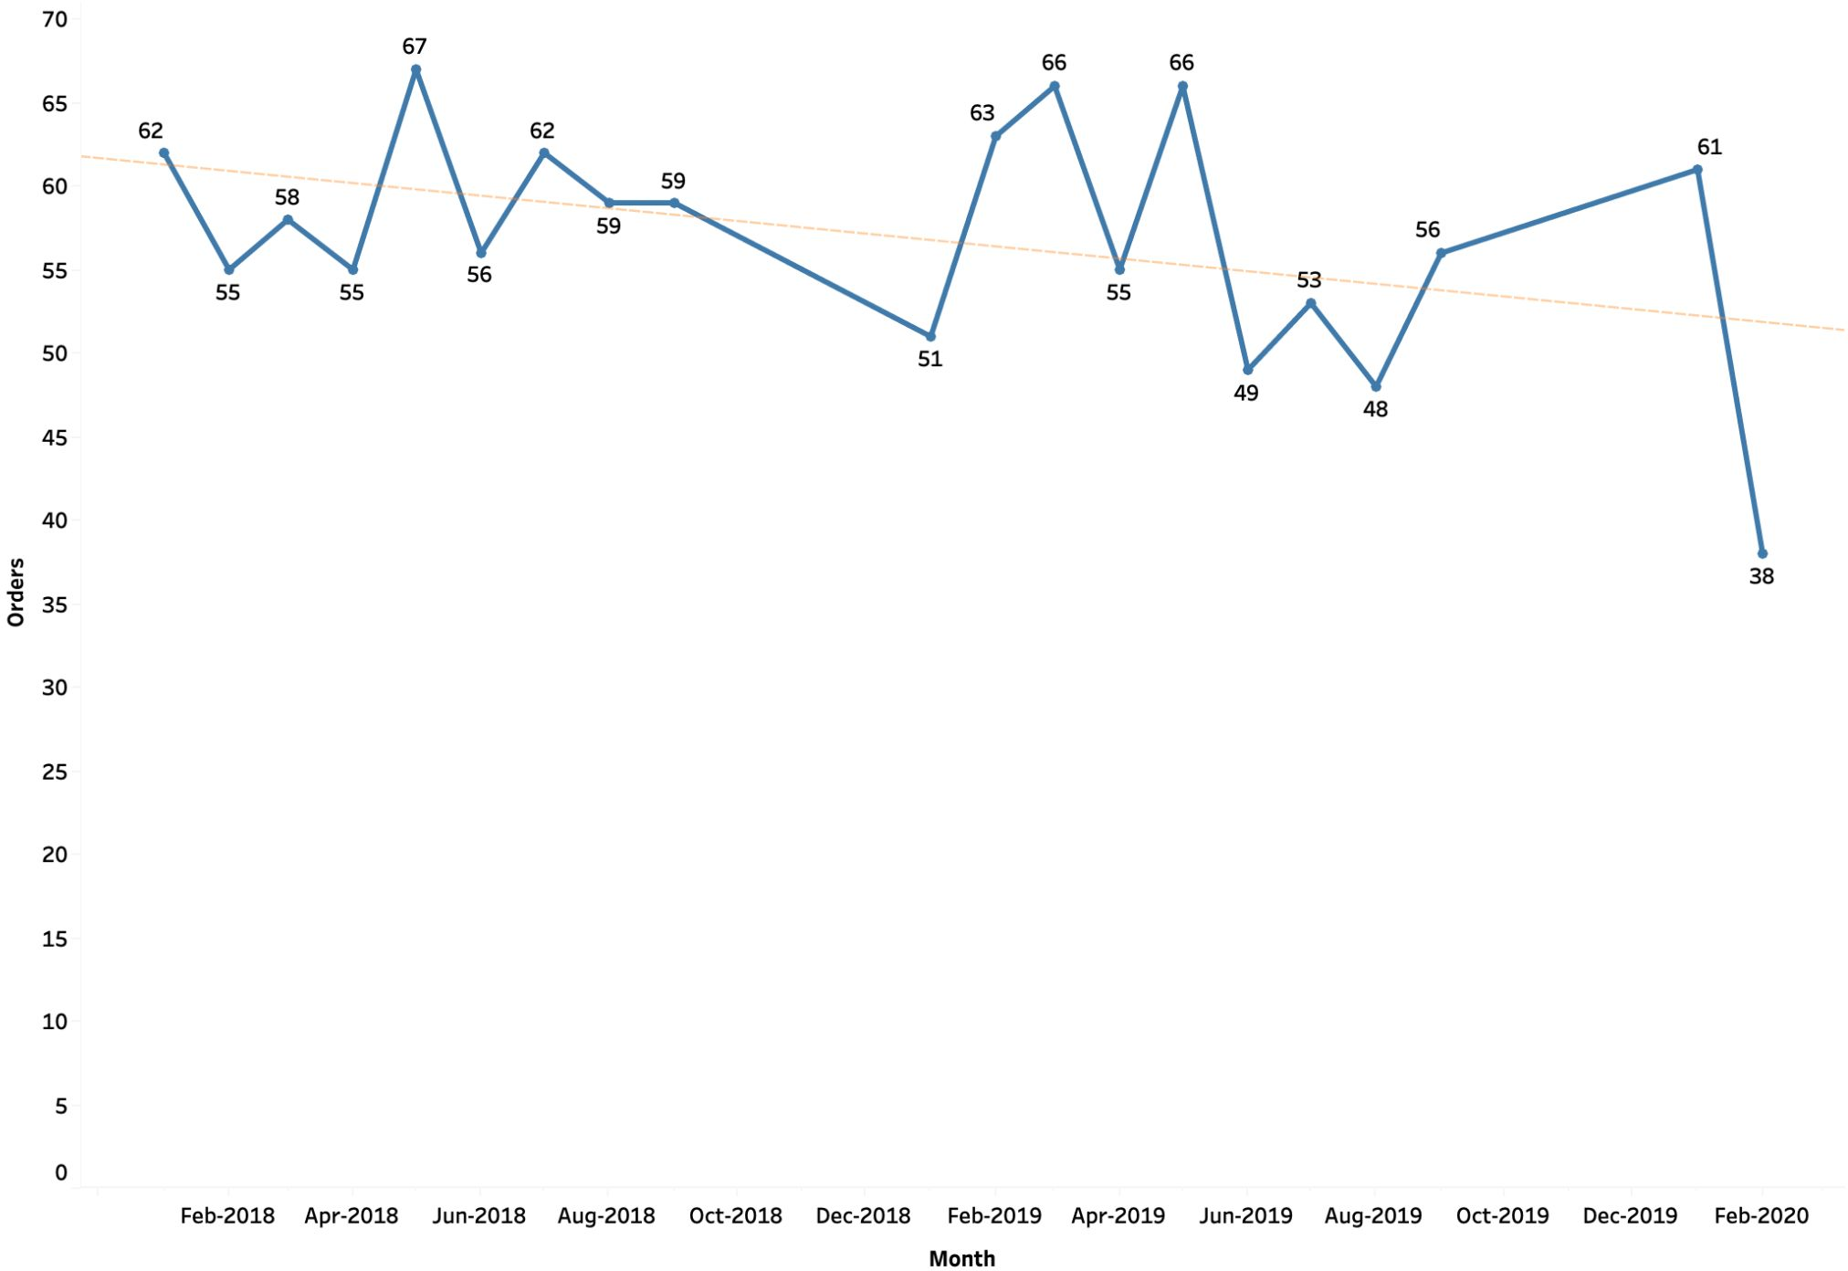
Orders Over Time: Monthly Order Trend
Inference:
Highest sales observed in May 2018 (67 Orders).
This is followed by Mar 2019 & May 2019 (66 Orders each

Slide 18
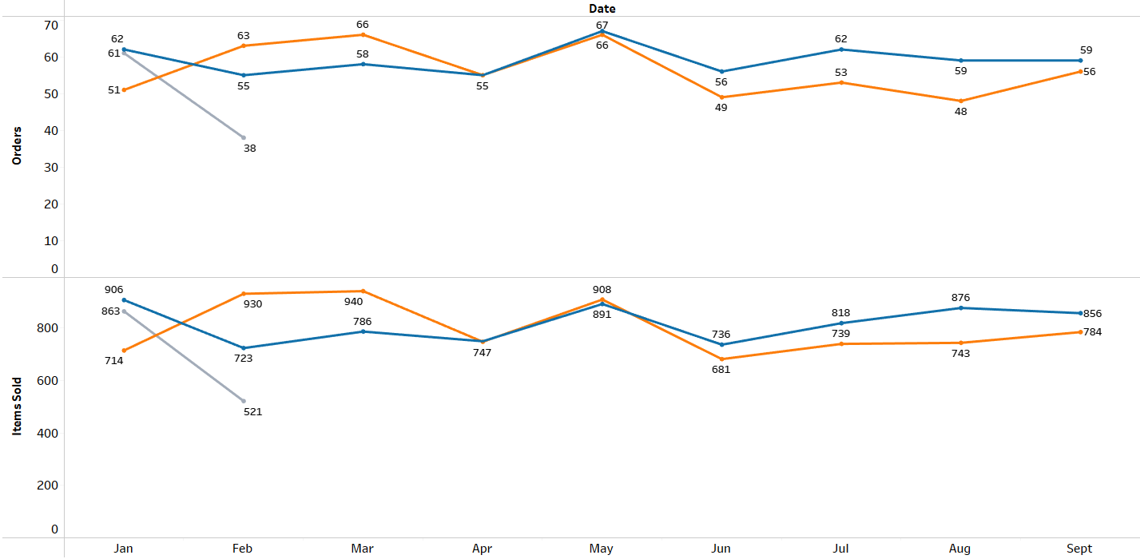
Orders Over Time: YOY Comparison
Inference:
Orders were highest in May month for both 2018 & 2019
Item sold hd a different peak than order count for both years.
Apr & June shows the dip for orders.
For 2020, only 2 months data available, However, Feb’20 shows huge dip

Slide 19
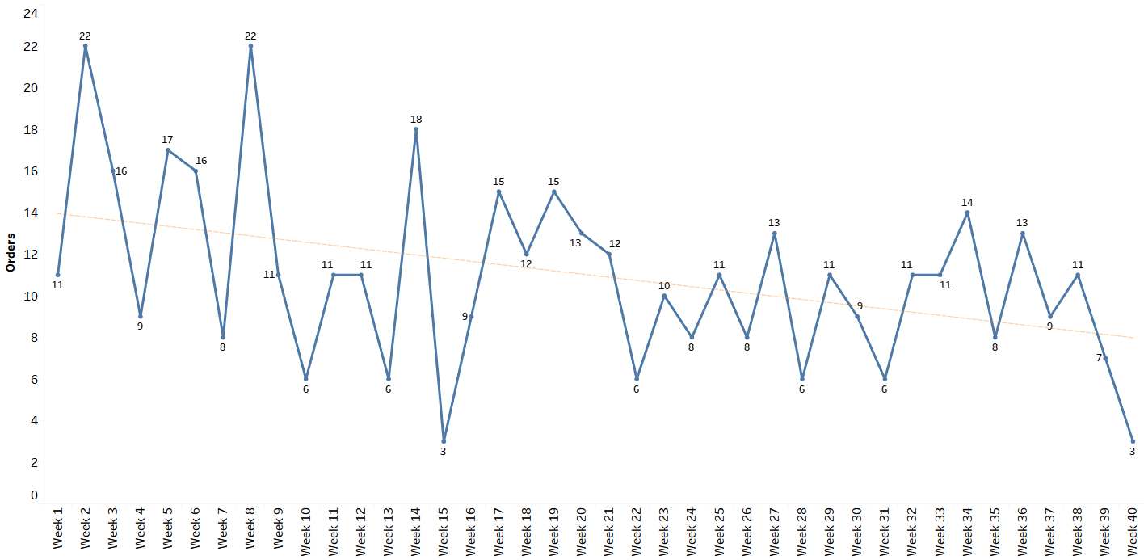
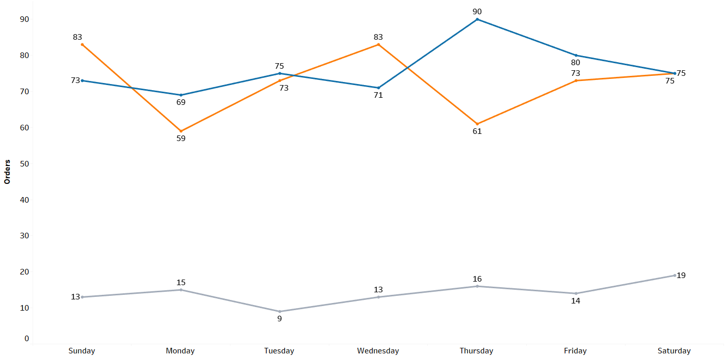
Orders Over Time: WOW Order Trend
Inference:
The Week Wise Trend is decreasing
Highest sales are in Week 8.
No particular pattern found in basis Weekday
For 2020, only 2 months data available

Slide 20
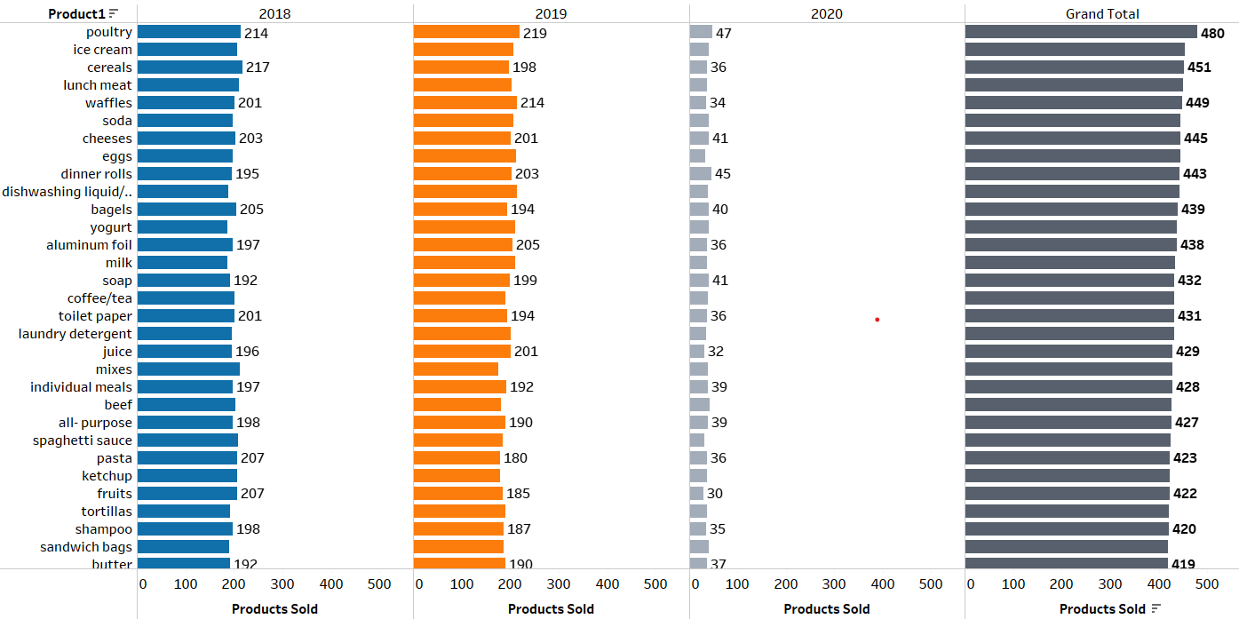
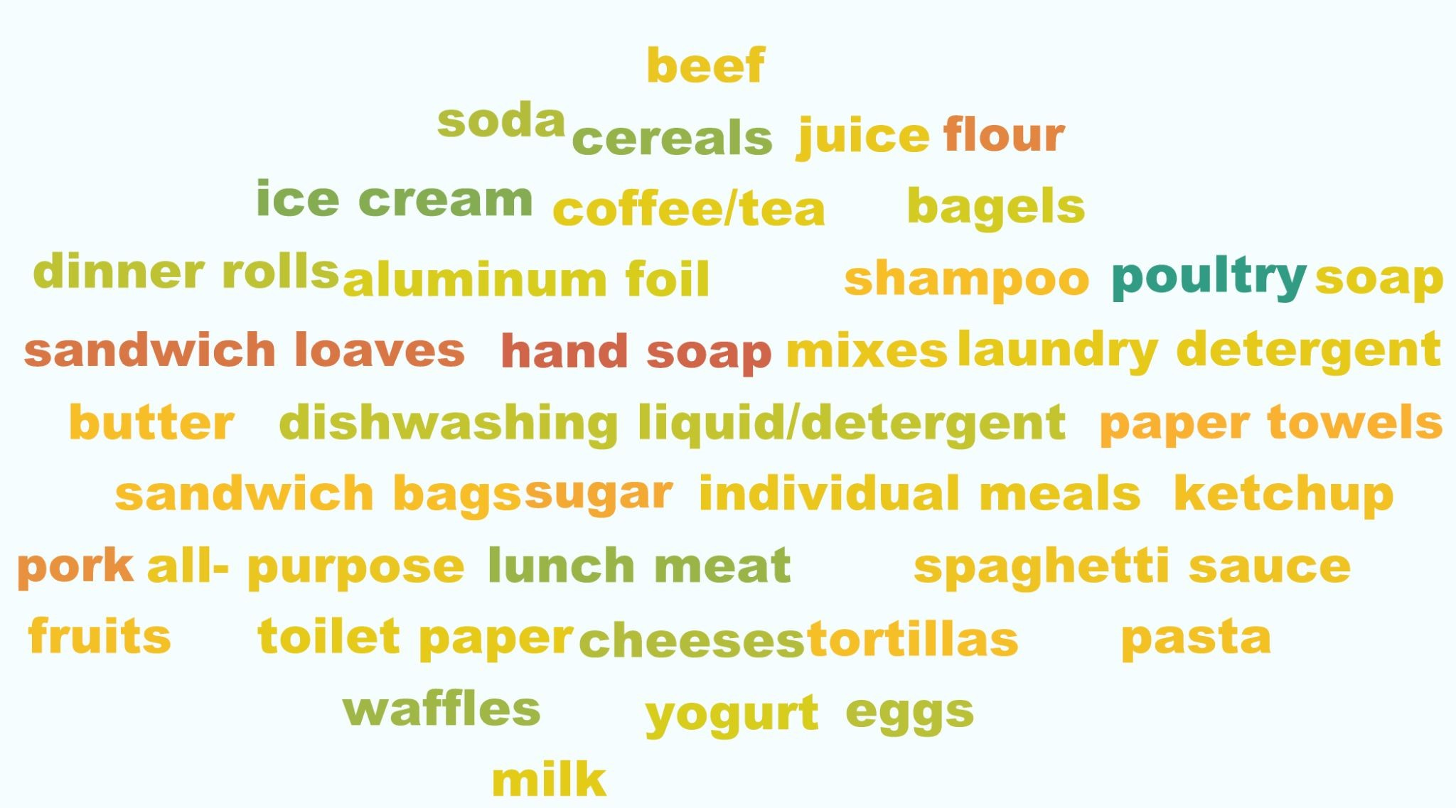

Top 10 Items Sold
Inference:
Poultry, ice cream, Cereals are the most popular products.
Hand Soap, Sandwich Loaves, flour, pork are the least popular products.

Slide 21
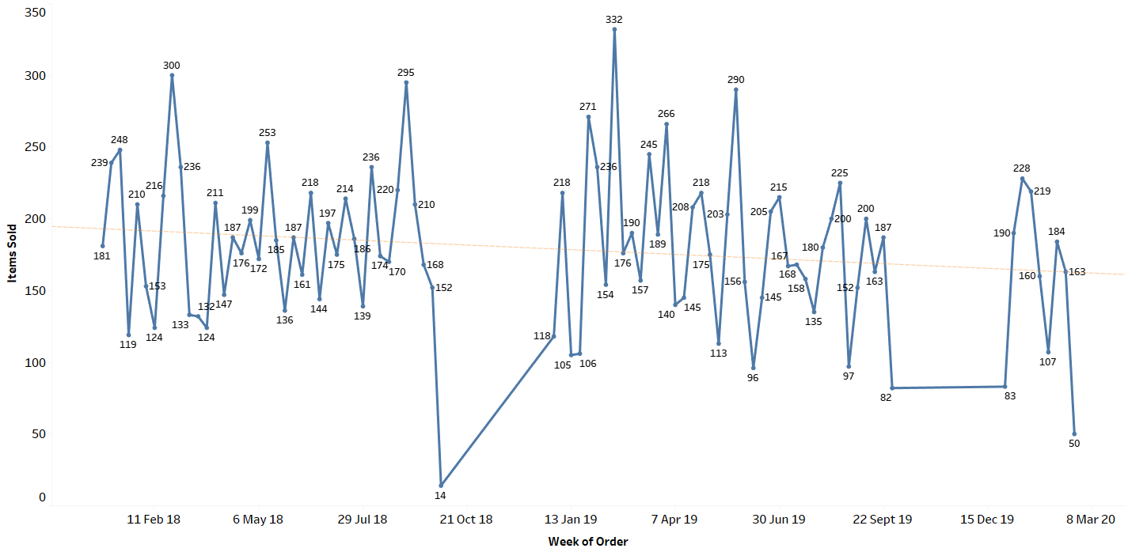
Weekly Product Demand
Insights
Product sold is in decreasing trend for most of the items.
On Analysing the Trend line, coefficient of slope for all products are in negative.
This suggests decreasing trend, except Yogurt which has a slight positive Slope coefficient .
Hence, we can say that, except Yogurt, all products demand is decreasing

Slide 22
Summary of Exploratory Analysis
Sales Overview:
The data is, starting from January 1, 2018 having Over a 2-year and 2-month period. A total of 15,911 products were sold through 1,13 9 orders.
Unfortunately, there's no data available for the fourth quarter in both years.
Yearly Comparisons:
In 2019, the total number of orders decreased by 26 compared to the previous year (2018).
Additionally, the total number of products sold experienced a decrease of 155 units in 2019 compared to 2018.
Trend Analysis:
A consistent decreasing trend was observed in the number of orders over the analyzed period.
There was a mild decline in the total number of products sold, although not as pronounced.
A gradual decline was noted in sales and orders after May. Product Popularity
Among 37 products, clear preferences emerged.
Poultry, ice cream, and cereals were the most popular choices among customers.
Conversely, hand soap, sandwich loaves, flour, and pork ranked as the least popular products during this period.
Weekly Demand Trends:
Weekly demand trends for most products displayed a consistent decrease over time.
One product, yogurt, showed a slight positive increase in demand.

Slide 23

Recommendation:
Focus on promoting and stocking up on poultry, soda, and cereals as they are consistently top-selling products.
Consider increasing the stock of soap and toilet paper as they are the highest sold non-eatable products.
Evaluate the reasons behind the low sales of hand soap and take measures to increase its sales.
Schedule promotions and offers on Sundays to maximize sales on the day with the highest sales.
Plan marketing campaigns and discounts during February to increase sales during the historically low-sales month.
Plan marketing campaigns and discounts during January and March to increase sales during the historically high-sales months.
Aim to replicate the sales patterns of Q1 2019 and Q3 2018.
Keep the stock of products sold in Q2 consistent with the previous years to maintain sales levels.
Keep in mind the limited data for 2020 while making sales and marketing decisions.

Slide 24

MARKET BASKET ANALYSIS

Slide 25
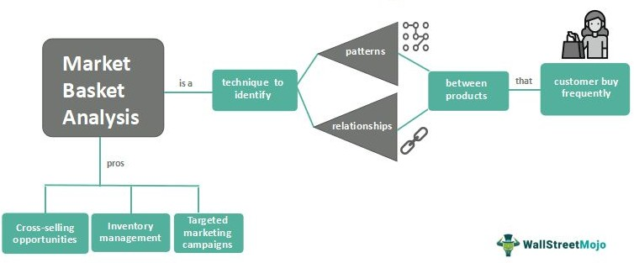
Market Basket Analysis
Definition: Market Basket Analysis is a statistical technique that analyzes customer purchase patterns to identify associations between different products. It helps businesses understand which products are frequently purchased together and how customers' buying habits affect sales.
Data: To conduct market basket analysis, businesses need transactional data that includes details such as customer ID, product ID, and transaction date. This data is then used to create a matrix that represents the relationships between different products.
Association Rules: Association rules are used to identify the strength of the relationship between different products. These rules are expressed in terms of support, confidence, and lift. Support refers to the frequency of co-occurrence of items in a transaction, while confidence measures the probability that if a customer buys one item, they will also buy another. Lift measures the degree of correlation between two items.
Applications: Market Basket Analysis is used in a variety of industries, including retail, e-commerce, and marketing. Retailers use this technique to optimize product placement and promotions. E-commerce companies use it to personalize product recommendations, and marketers use it to develop targeted advertising campaigns.
Benefits: Market Basket Analysis helps businesses increase revenue by identifying cross-selling opportunities and developing targeted promotions. It also helps improve customer satisfaction by providing personalized recommendations and improving the overall shopping experience

Slide 26
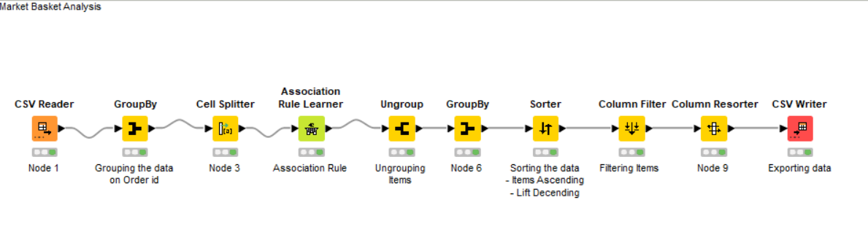
Market Basket Analysis : KNIME WORKFLOW

Slide 27
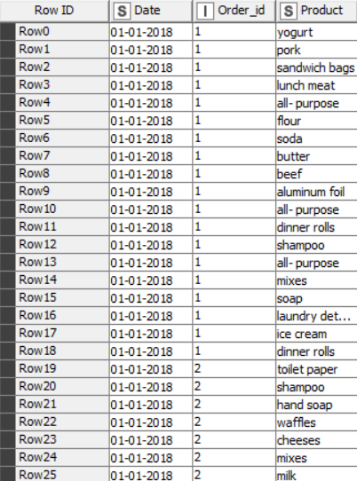
Sample Output Table

Slide 28

Associations Rule

Slide 29
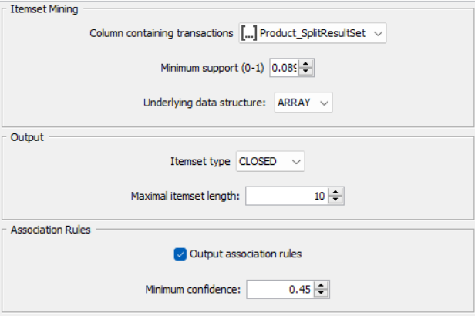
Association Rule Parameters
Support of Minimum: 0.05
Maximum Item Set Length : 10
Minimum Confidence Level:0.6

Slide 30
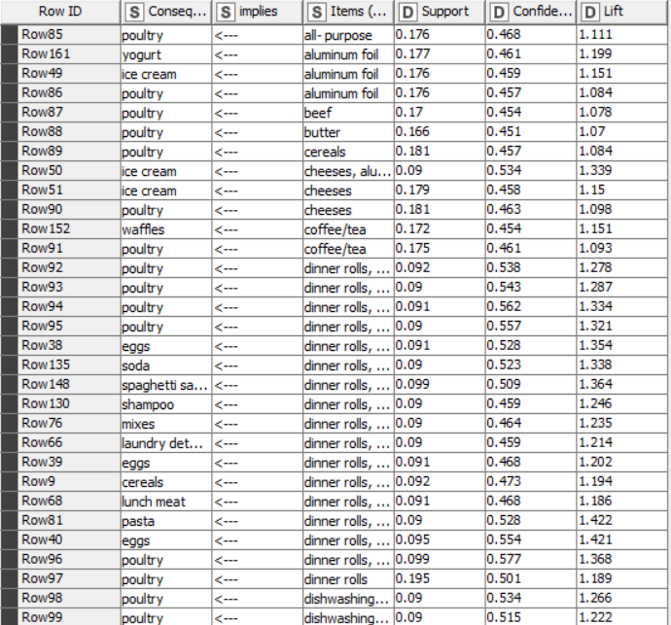
Associations : KNIME Output

Slide 31
Associations
The generated association rules serve as a recommendation system during customer shopping experiences.
Recommendation Logic: If a customer shows interest in or has items from Set A in their cart, they will be recommended products from Set B.
Priority Order: When multiple products (consequents) are associated with an item in Set A, the recommendation order is determined by the lift value. The product with the highest lift is recommended first, followed by others.
Example: As an illustration, consider the association rules pertaining to Yogurt
Item | Implies | Consequent | Support | Confidence | Lift
Yogurt | => | Juice | 0.176 | 0.459 | 1.218
Yogurt | => | Aluminum foil | 0.177 | 0.461 | 1.199
Yogurt | => | Eggs | 0.175 | 0.454 | 1.166
Yogurt | => | Waffles | 0.174 | 0.452 | 1.147
Yogurt | => | Poultry | 0.181 | 0.470 | 1.116
If a customer purchases Yogurt, the first recommendation will be of Juice as it has a higher probability of being purchased along with Juice based on past data (higher lift).
Then Aluminum Foil, Eggs in that order.

Slide 32

Recommendations

Slide 33
Recommendation - 1
Item | Implies | Consequent | Support | Confidence | Lift
Spaghetti sauce, Poultry | => | Dinner rolls | 0.099 | 0.579 | 1.490
Dinner rolls, Poultry | => | Spaghetti sauce | 0.099 | 0.509 | 1.364
Dinner rolls | => | Poultry | 0.195 | 0.501 | 1.189
Poultry | => | Dinner rolls | 0.195 | 0.463 | 1.189
Spaghetti sauce | => | Dinner rolls | 0.172 | 0.461 | 1.186
Spaghetti sauce | => | Poultry | 0.171 | 0.459 | 1.089
Smart Pairing: Combine Dinner Rolls, Spaghetti Sauce, and Poultry to create attractive product bundles. Offer discounts for customers buying all three or a "buy 2 get 1 free" deal.
For example: purchasing Dinner Rolls and Poultry would include Spaghetti Sauce at no extra cost.
Demand Insights: While Spaghetti Sauce demand is declining, Poultry and Dinner Rolls show steady or slightly increasing weekly demands, with Poultry being the top seller.
Boost Sales: Pairing Spaghetti Sauce with Poultry and Dinner Rolls can rejuvenate Spaghetti Sauce sales. This approach not only drives sauce sales but also encourages customers to choose the combo, boosting overall sales and customer satisfaction.

Slide 34
Recommendation - 2
Item | Implies | Consequent | Support | Confidence | Lift
Ice Cream, Soda | => | Waffles | 0.090 | 0.536 | 1.361
Ice Cream, Waffles | => | Soda | 0.090 | 0.523 | 1.338
Waffles, Soda | => | Ice Cream | 0.090 | 0.510 | 1.279
Soda | => | Waffles | 0.177 | 0.454 | 1.152
Combo Deals: Explore bundled offers for Ice Cream, Soda, and Waffles, allowing customers to purchase these products together at a reduced price. Consider implementing a "buy 2 get 1" promotion, where buying Ice Cream and Soda includes a complimentary pack of Waffles.
Demand Boost: While Waffles face decreasing demand, Ice Cream and Sodas show steady to slightly increasing weekly demand. By pairing them together, you can revitalize Waffles sales and entice customers to opt for the combo.

Slide 35
Recommendations - Summary
Boost Sales with Smart Strategies:
Combo Deals: Offer discounted schemes for product combinations: Offer a "Buy Two Get One Free promotion to encourage customers to purchase more items at once.
Dinner Rolls, Spaghetti Sauce & Poultry
Yogurt, Juice & Aluminum Foil
Ice Cream, Soda & Waffles
Promotional Sales: Implement frequent sale offers for slower-selling products such as Hand Soap, Sandwich Loaves, and fruits. Create a "Paper Products Bundle" offer that includes paper towels, toilet paper, and/or tissues at a discounted price.
Leverage Associations: Explore additional product associations to enhance sales:
Soda & Eggs
Dinner Rolls & Eggs
Ice Cream & Cheeses
Yogurt & Poultry
Lunch Meat & Poultry
Consider bundled offers for these product pairs, providing customers with a discounted rate when purchasing them together. This strategy can boost sales for these products and create a mutually beneficial sales impact.
These discount offers and combos can help increase sales by providing customers with more value for their money and encouraging them to purchase more items. It is important to promote these offers through in-store signage, advertisements, and social media to ensure customers are aware of the deals available.

Slide 36

Thank You

